Slide 1
MSSP 608: Practical Machine Learning Methods Week 8
1

Slide 2
House Keeping
Please read assignment directions and announcements carefully
turning in late;
Not uploading google colab
Quiz 7 due Tuesday for section 001; Thursday for section 003
Assignment 3 due on March 25 at 11:59 p.m. EST
“Great” example from last semester posted on Canvas
Moving forward, tardiness and missing classes will impact your grade
Assignment 2 graded by Wednesday.
TA’s will comment on all point reductions

Slide 3
Road Map…
Prior weeks
This week
Validation | ML Algorithms
 | Supervised | Unsupervised | Reinforcement
 | Decision trees | Prin. Comp. Anal. (PCA)
Test/train (hold out cross validation) | Linear regression | K-means
K-fold cross-validation | Logistic regression
Stratified cross-validation | Random Forests (bagging method)
Hyperparameter tuning (ridge, lasso, elastic net regression) | Support vector machines (SVM)
Ensemble learning | K-nearest neighbors (knn)
Bagging
Boosting

Slide 4
Quiz #6 class average – 95%
4

Slide 5
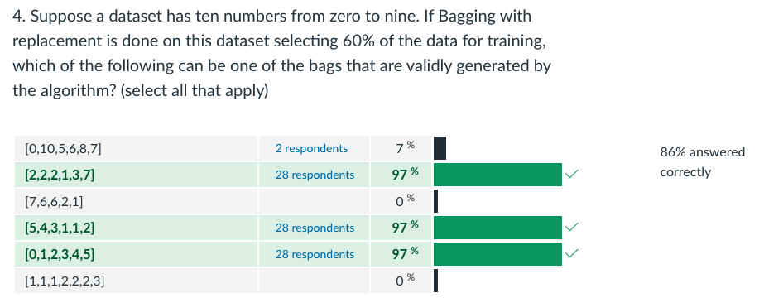
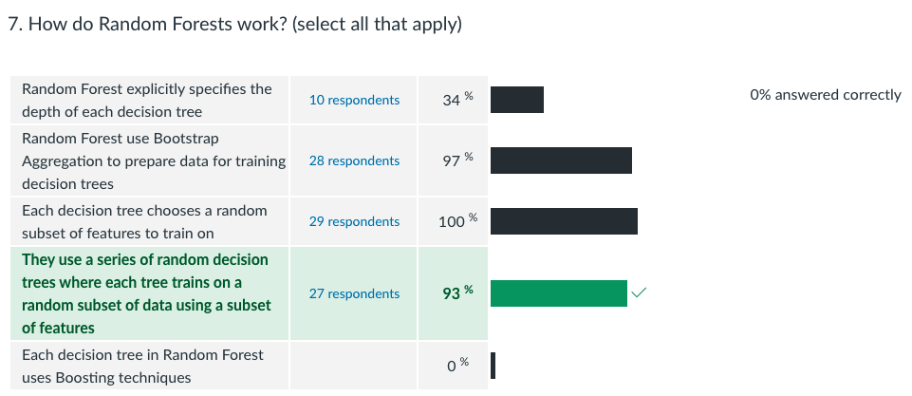
Quiz 6 (1)

Slide 6
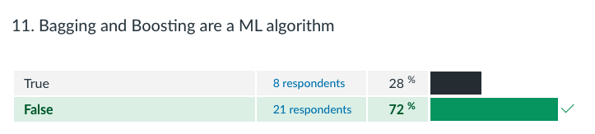
Quiz 6 (2)

Slide 7
Assignments:
Assignment 2:
Currently being graded (released by Wednesday)
Point deductions will be listed in comments
Assignment 3:
Posted on Canvas
“A+” example also posted on Canvas
No coding required
Due March 25th at 11:59 PM EST
Assignment 4:
Due April 8th
You will learn everything for Assignment 4 today (unsupervised learning)
“cheat sheet” to be posted this weekend
Assignment 5:
- Due April 22nd
Notes:
Ask clarifying questions
Identify the key goal of case study
Map out solution for how LendingTree can reach their goal (NOT ANALYSIS)
What analytic strategy (ML based) will reach address goal of study

Slide 8
Assignments
8

Slide 9
LendingTree:
LendingTree case study
Borrowers submit loan requests
Lenders
10,000 applications
LendingTree platform
2000 applications fulfilled (20%)
LendingTree earns a fee on successful loan requests
Success loan requests

Slide 10
Findings from Assignment 1:
Label
Accept/Reject (we had to label – 0 and 1 – 0 indicted rejected borrowers and 1 represented accepted)
4 features:
Loan amount
FICO score
DTI
Employment length
Algorithm:
Decision Tree
Test/train:
Hold out (70/30 train/test split)
Accuracy:
~94.7% accuracy
Notes:
Ask clarifying questions
Identify the key goal of case study
Map out solution for how LendingTree can reach their goal (NOT ANALYSIS)
What analytic strategy (ML based) will reach address goal of study

Slide 11
Case Study
Our client, LendingTree, thanked us for our initial analysis but are concerned that the algorithm we provided has not yet been optimized. The CEO expressed that “our initial results were a good start but we need additional analytics to ensure we have fully optimized the solution before it goes ‘live’.”
Remember steps of case study…
Clarifying questions
Identify the key goal
Map out solution (not yet the analysis)
Analysis plan
Notes:
Ask clarifying questions
Identify the key goal of case study
Map out solution for how LendingTree can reach their goal (NOT ANALYSIS)
What analytic strategy (ML based) will reach address goal of study

Slide 12
How to optimize?
What is objective ?
Map out solution?
Combinations of features (assignment 1 used all 4)
Less complex, faster, more generalizable
Decision vs. logistic regression
Lower variance – results more model accuracy on test data
Hyperparameter tuning
Number of layers; minimum number of obs for leaf/split/node
Important because…helps prevents overfitting
K-fold cross-validation – k-fold stratified cross-validation
Hold out methods may have different proportion of accept/reject in train/test split
Notes:
k-fold stratified cross validation vs. hold out (5-folds)
Decision tree vs. random forest (ensemble)
Decision tree vs. logistic regression
Compare different combinations of the 4 features
Compare different test split sizes (i.e., 0.30 vs. 0.20 vs. 0.05)
Hyperparameter tuning for decision tree
Minimum obs for node split (# of obs bf a split)
Minimum obs for leaf
Max depth of a tree
Criterion (entropy vs. gini index)

Slide 13
How to optimize?
Map out solution?
k-fold stratified cross validation vs. hold out (5-folds)
Decision tree vs. random forest (ensemble)
Decision tree vs. logistic regression
Compare different combinations of the 4 features
Compare different test split sizes (i.e., 0.30 vs. 0.20 vs. 0.05)
Hyperparameter tuning for decision tree
Minimum obs for node split (# of obs bf a split)
Minimum obs for leaf
Max depth of a tree
Criterion (entropy vs. gini index)
Notes:
k-fold stratified cross validation vs. hold out (5-folds)
The solution is optimized via k-fold stratified cross validation because it ensures balance in the train/test sets for the proportion of accepted applications whereas the hold method does not. Our result confirm this because our accuracy increased to 96%.
Decision tree vs. random forest (ensemble)
Decision tree vs. logistic regression
This solution could be optimized because decisions are subject to overfitting and thus are less generalizable whereas logistic regression is a high bias/low variance algorithm and thus are more generalizable and possibly resulting in increased accuracy. Our results do not confirm our initial hypotheses as results yielded a 90% accuracy.
Compare different combinations of the 4 features
This solution could be optimized by creating a more parsimonious model – i.e., this is a less complex model, less likely to be overfitted, and thus more generalizable.

Slide 14
Review (last week)
14

Slide 15
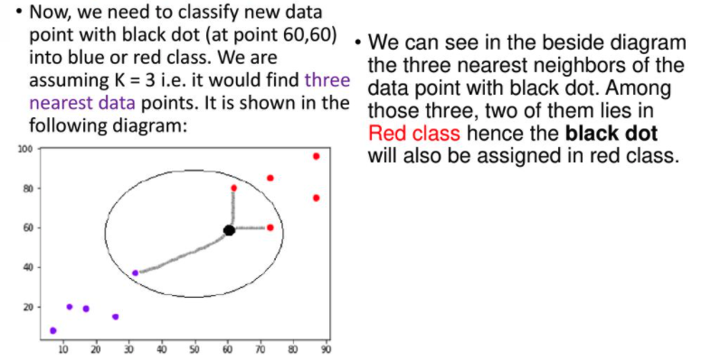
K-nearest neighbors:

Slide 16
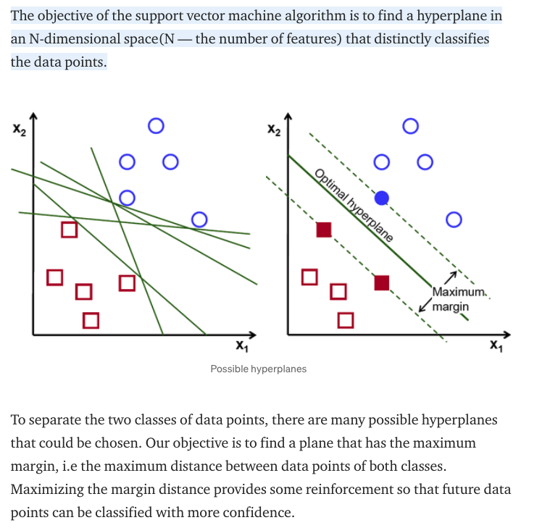
What is Support Vector Machine?

Slide 17
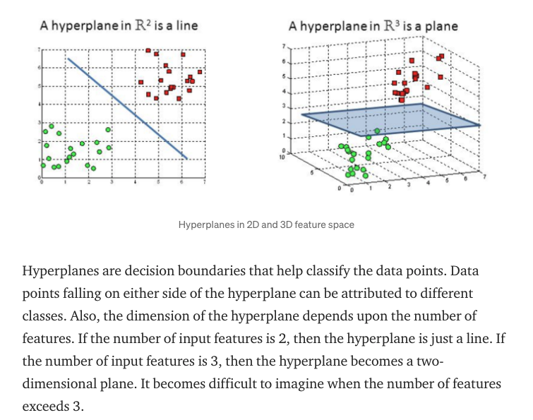
What is a hyperplane?

Slide 18
This week
18

Slide 19
Concepts:
Principal component analysis
K-means
Hierarchical clustering

Slide 20
Principal component analysis
20

Slide 21
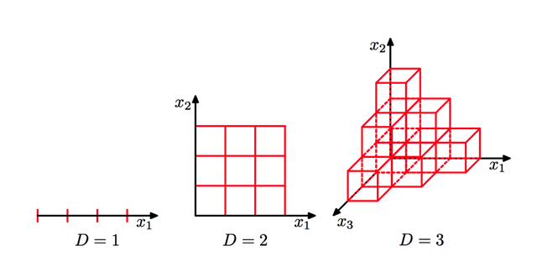
Principal Component Analysis (PCA):
Unsupervised, non-parametric statistical technique primarily used for dimensionality reduction in machine learning.
High dimensionality means that the dataset has a large number of features.
The primary problem associated with high-dimensionality in the machine learning field is model overfitting, which reduces the ability to generalize beyond the examples in the training set.
“Many algorithms that work fine in low dimensions become intractable when the input is high-dimensional.”

Slide 22
Principal Component Analysis (PCA):
The ability to generalize correctly becomes exponentially harder as the dimensionality of the training dataset grows
PCA can also be used to filter noisy datasets, such as image compression. The first principal component expresses the most amount of variance. Each additional component expresses less variance and more noise, so representing the data with a smaller subset of principal components preserves the signal and discards the noise.

Slide 23
K-means
23

Slide 24
Hierarchical clustering
24

